Slide 1
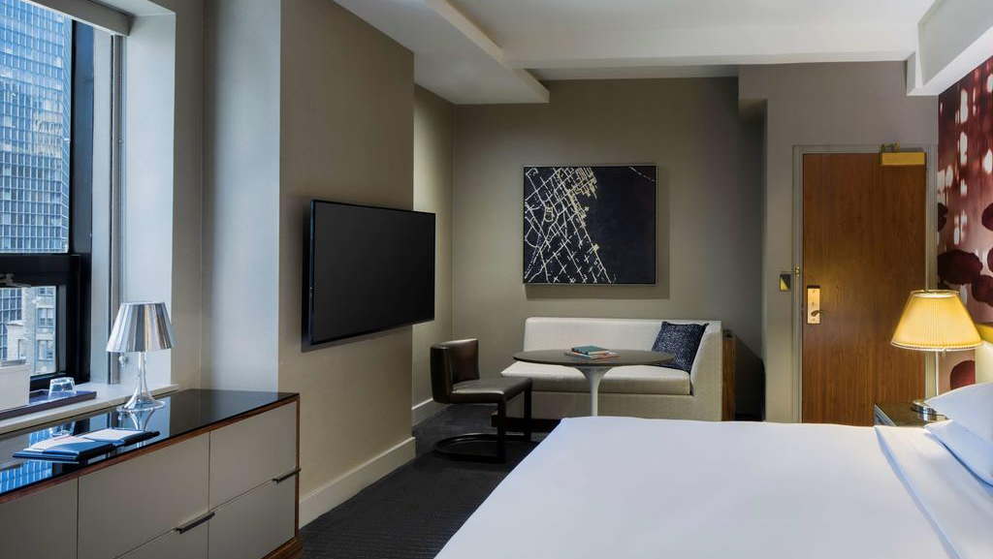

HYATT
HOTELS
DATA
SCIENCE
Minu Abi, Mohit Gupta, Palak Nyati, Raghav Raheja, Wanting

Slide 2

Overview
This project aims to help Hyatt hotels find factors that will help them understand their customers better in order to increase the likelihood of a customer to recommend the hotel to another person.

Slide 3
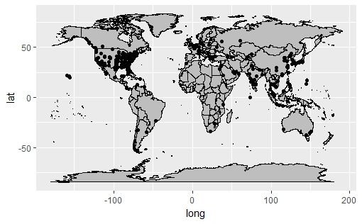
DATA SELECTION
Focused analysis on Hyatt’s US locations
Analyzed data for months: January, April, May and December
Divided guests into two categories: Business and Leisure
Focused on hotels in New York and California

Slide 4
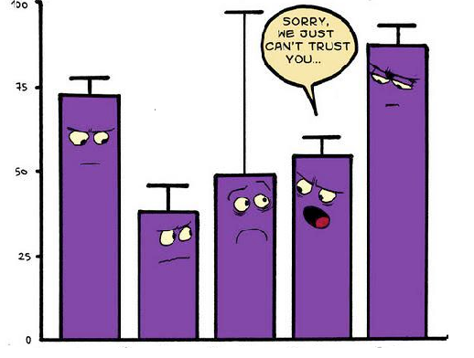
Data Modelling
Techniques Used
Linear Modelling
Association Rules
Support Vector Machines (SVM)
Naive Bayes

Slide 5
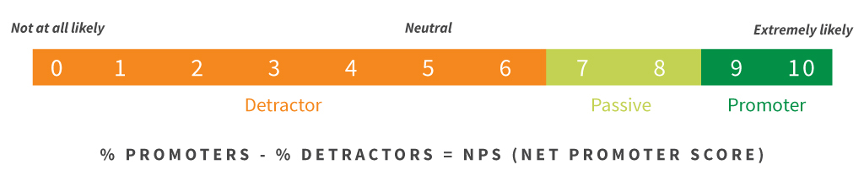
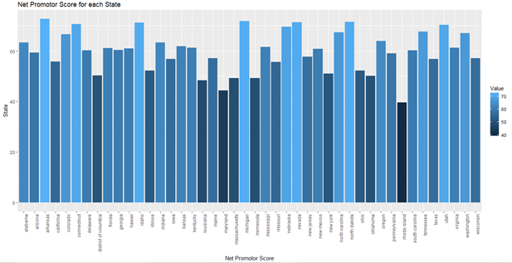
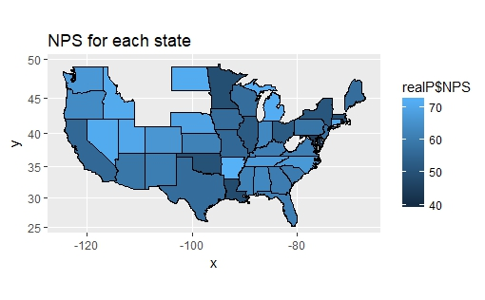
NET PROMOTER SCORE FOR DIFFERENT STATES
Net Promoter Score measures a customer's willingness to recommend a company or entity’s products to other people.
NPS = Percentage of promoters - Percentage of detractors
After calculating NPS for each state, we know that Arkansas has the highest NPS and Maryland has the lowest NPS.

Slide 6
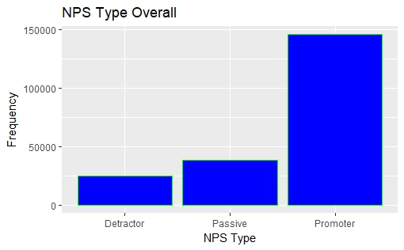
NPS Type For
Hyatt
NPS Type shows that clearly there
are more number of promoters!!!

Slide 7
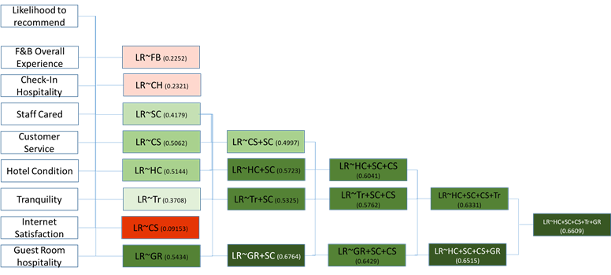
LINEAR MODELLING
On the overall data
S
It is an attempt to explain the changes in a continuous variable as a result of changes in other (predictor) variables
W
O
RESULTS OF THE MODEL:
Likelihood to Recommend(LR) can be explained as a factor of Hotel Condition((HC) , Staff Cared(SC), Customer Service(CS), Tranquility(Tr) and Guest Room hospitality(GR).
This means that about almost 66% of the variability in likelihood to recommend can be explained as a result of these variables.

Slide 8
Association
Rules Mining
On the overall data
Significant Contributors from arules analysis
Association rules mining is a technique to understand the relationship and effect of a categorical factor on a dependent variable.
Reservation Offer
Mini Bar
Spa
Restaurant
Golf
Fitness Centre
Conference Room
Casino
Business Center
Reservation Offer

Slide 9
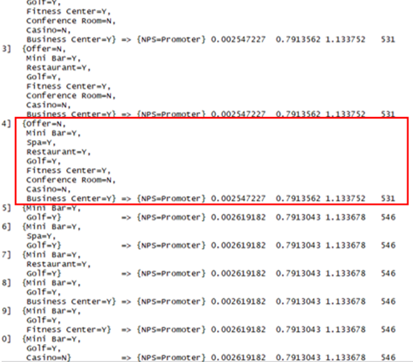
This means that the combination, where Offer = N, Mini Bar = Y, Spa = Y, restaurant = Y, Golf = Y, Fitness center = Y, Conference Room = N, Casino = N, Business center = Y, is the one that results in most customers being Promoters that is a whopping 79%.
On the other hand, this model offers strong evidence that the presence of a mini bar, spa, restaurant, a golfing facility and a fitness center can significantly increase a customer's likelihood to recommend the Hyatt hotel in question to other people.

Slide 10
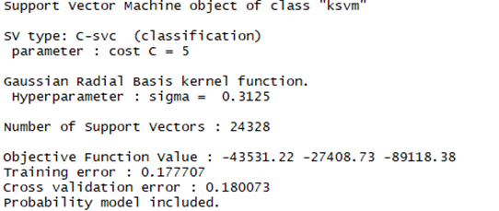
Support Vector Machines (SVM)
On overall data
In this report, an SVM analysis is conducted to see how well the NPS Type can be predicted based on our significant explanatory variables.
RESULT OBTAINED
Variables such as Hotel Conditions, Staff Cares, Customer Service, Tranquility and Guest Room Hospitality can successfully be used to predict the NPS Type about 82% of the time, which is a significantly high number.
If Hyatt focuses on the above mentioned factors, it’s overall likelihood to recommend should increase resulting in a higher Net Promoter Score.

Slide 11
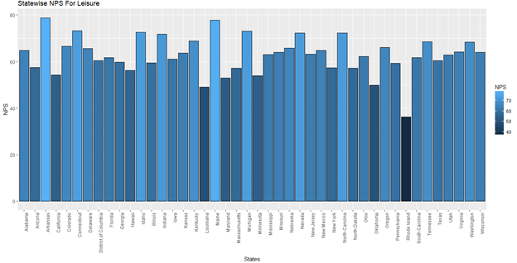
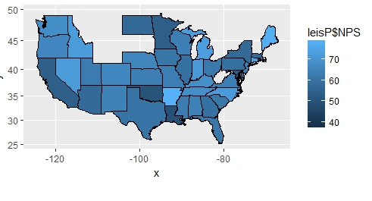
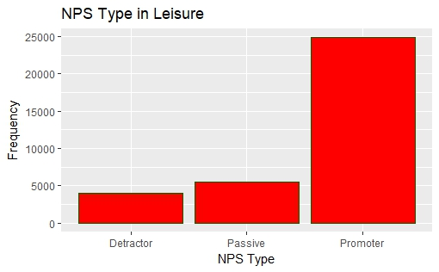
NPS for Leisure
Guests
Statewise NPS Score for Leisure
NPS Type in Leisure
NPS Score for each state based for leisure purpose

Slide 12
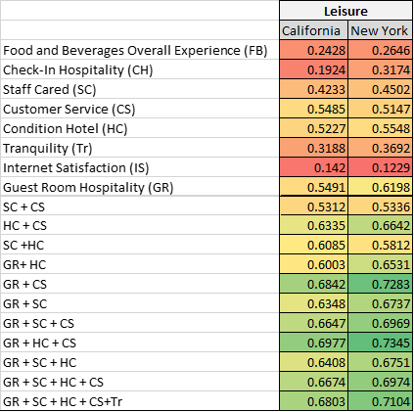
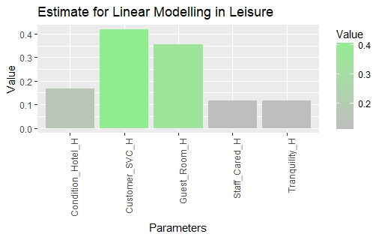
Linear Modelling
for leisure customers
INFERENCE FROM THE TABLE
We note that likelihood to recommend can be explained as a factor of Guest Room Hospitality (GR), Hotel Condition (HC) and quality of Customer Service (CS).
In California almost 69% of the variability in likelihood to recommend can be explained as a result of these variables.
In New York, almost 74% of the variability in likelihood to recommend can be explained as a result of these variables.
INFERENCE FROM THE GRAPH
The graph shows the significance of the coefficients of our independent variables to predict likelihood to recommend.
We note that Customer Service impacts the likelihood to recommend more sharply than any other variable followed by Guest Room Hospitality, Hotel Condition, Staff Cared and Tranquility respectively.

Slide 13
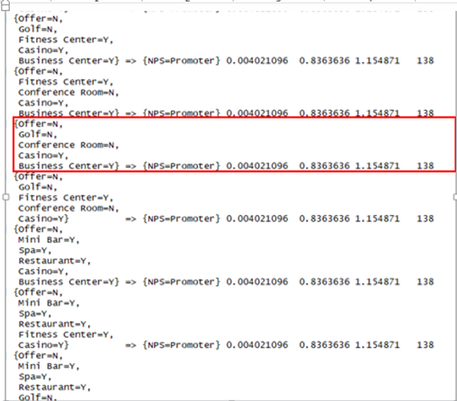


Association Rules
for leisure customers
INFERENCE FROM ARULES
We have used Arules here to understand relationship and effect of categorical variables on a customer’s NPS type for Hyatt’s Leisure customers.
According to this rule, leisure customers tend to be promoters a big 83% of the times when the following combination occurs when:
Reservation Offer
Golf Facility
Conference Room
Casino
Fitness Center
This suggests that the presence of a golfing facility, offer or conference room does not have a significant impact on a leisure customer’s decision to recommend the hotel.
Hence to boost NPS score for leisure customers, the hotel should focus more on factors such as casino and fitness room.

Slide 14
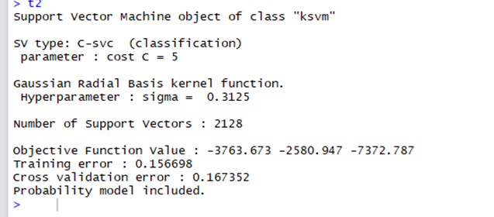
SVM
for leisure customers
INFERENCE FROM SVM ANALYSIS
We have performed SVM analysis to see how well can the NPS type be predicted based on significant explanatory variables shortlisted from the linear model for leisure customers.
Variables such as Hotel Conditions, Staff Cares, Customer Service quality, Tranquility and Guest Room Hospitality can successfully be used to predict the NPS Type about 83% of the time, which is a significantly high number.
On a side note: The above inference is pretty much the same as that for the overall SVM analysis.

Slide 15
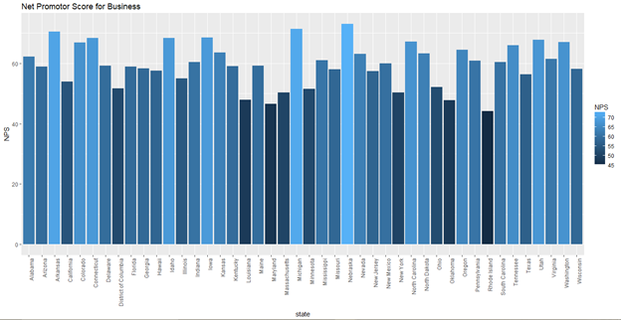
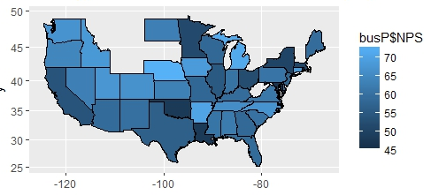
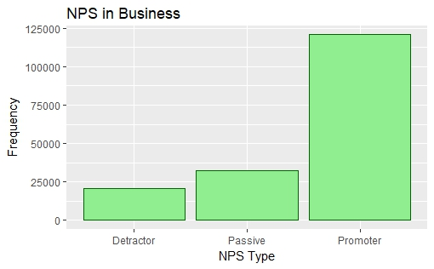
NPS for Business
Guests
Statewise NPS Score for Business
NPS Type in Business
NPS Score for each state based for Business purpose

Slide 16
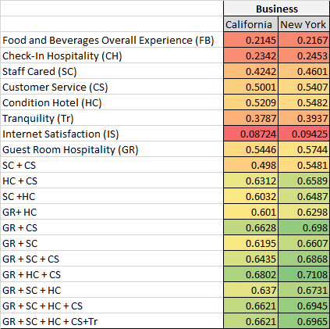
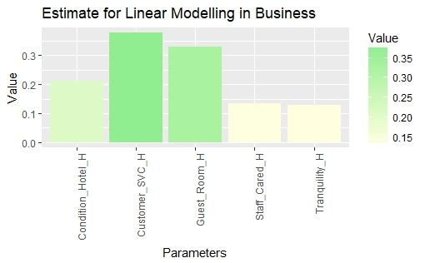
Linear Modelling
for Business customers
INFERENCE FROM THE TABLE
We note that likelihood to recommend can be explained as a factor of Guest Room Hospitality (GR), Hotel Condition (HC) and quality of Customer Service (CS).
In California almost 68% of the variability in likelihood to recommend can be explained as a result of these variables.
In New York, almost 71% of the variability in likelihood to recommend can be explained as a result of these variables.
INFERENCE FROM THE GRAPH
The graph shows the significance of the coefficients of our independent variables to predict likelihood to recommend.
We note that Customer Service impacts the likelihood to recommend more sharply than any other variable followed by Guest Room Hospitality, Hotel Condition, Staff Cared and Tranquility respectively.

Slide 17
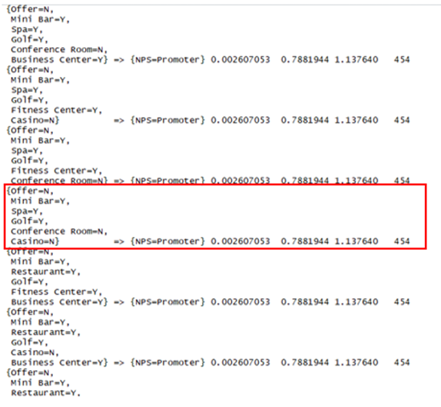
Association Rules
for Business customers
INFERENCE FROM ARULES
We have used Arules here to understand relationship and effect of categorical variables on a customer’s NPS type for Hyatt’s business customers.
According to this rule, business customers tend to be promoters a big 79% of the times when the following combination occurs:
Reservation Offer
Casino
Conference Room
Golf Facility
Spa
Mini Bar
This suggests that the presence of a casino, offer or conference room does not have a significant impact on a business customer’s decision to recommend the hotel.
Hence to boost NPS score for business customers, the hotel should focus more on factors such as spa, golf facility and mini bar.

Slide 18
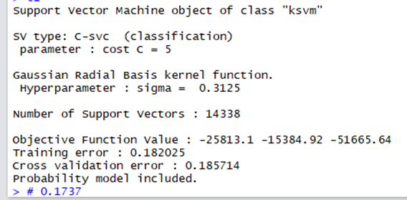
SVM
for Business customers
INFERENCE FROM SVM ANALYSIS
We have performed SVM analysis to see how well can the NPS type be predicted based on significant explanatory variables shortlisted from the linear model for leisure customers.
Variables such as Hotel Conditions, Staff Cares, Customer Service quality, Tranquility and Guest Room Hospitality can successfully be used to predict the NPS Type about 81% of the time, which is a significantly high number.
On a side note: The above inference is pretty much the same as that for the overall SVM analysis.

Slide 19
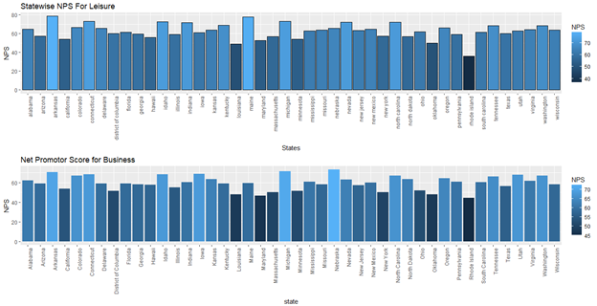
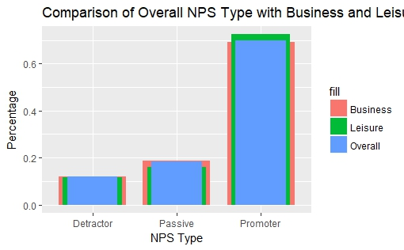
Comparing results of
Business and Leisure Customers
Comparison of overall NPS with Business and Leisure
Geographical Visualization of NPS for Leisure and Business across all US states

Slide 20
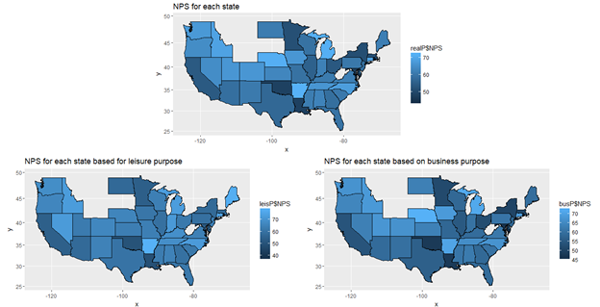
Analyzing
States Based on NPS
We realize from the charts that Arkansas and Maine have substantially high Net Promoter Score from people travelling for Leisure, when compared with people travelling for business.

Slide 21
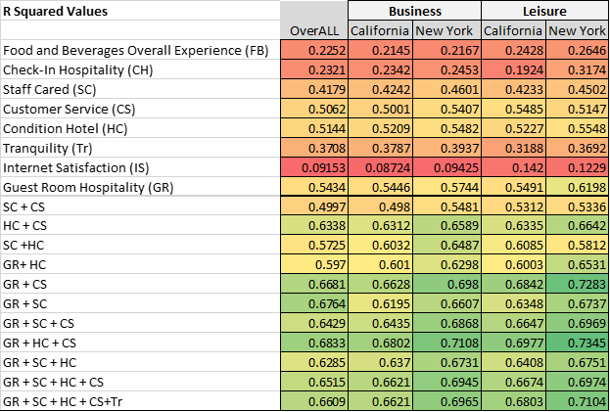
INFERENCE FROM TABLE
For both Business and Leisure customers in New York, likelihood to recommend can be explained as a factor of Guest Room Hospitality (GR), Hotel Condition (HC) and quality of Customer Service (CS).
However, leisure customers in New York give slightly more importance to these three factors when compared to business travelers.
Similarly for California, for both Business and Leisure customers, likelihood to recommend can be explained as a factor of Guest Room Hospitality (GR), Hotel Condition (HC) and quality of Customer Service (CS).
Even in California, leisure customers give more importance to these three factors.
Moreover, it is observed that New Yorkers as a whole tend to give more importance to these factors than Californians

Slide 22
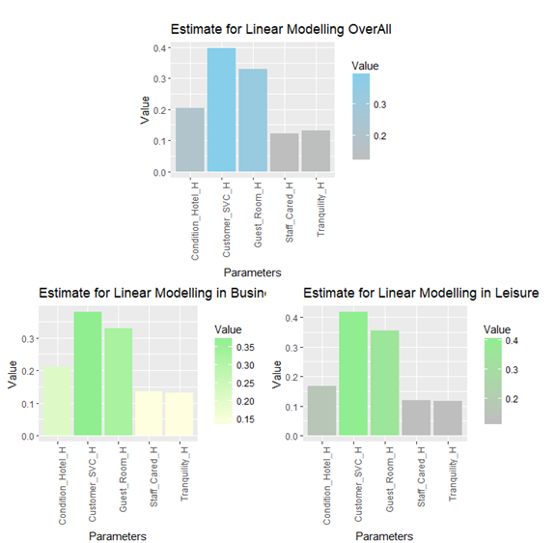
Analyzing
Coefficients of Variables
The coefficient of Hotel condition is significantly higher for business customers than it is for leisure customers.

Slide 23
Most business customers were promoters in instances when there was no casino in the hotel.
On the other hand, leisure customers react positively to the presence of a casino in the hotel in their decision to recommend the hotel and their overall satisfaction from it.

Slide 24
Recommendations
Hyatt should try to cater most of its services towards the preferences of business customers. Since a whopping majority of Hyatt’s guests are travelling for business purposes, it may be a good idea to add amenities that business customers prefer such as a mini bar, golfing facility etc.
Offer Casino facilities in areas where Hyatt receives more Leisure guests. The ARules analysis above showed how leisure customers prefer casinos more so than business customers.
As we saw from our analysis above, business customers value hotel conditions more so than leisure customers. In areas with a very high percentage of guests visiting for business, Hyatt should improve hotel conditions for hotels that need such improvement, and maintain good hotel conditions where available. This change can make significant strides in boosting the net promoter score.
Continue offering high Guest Room hospitality, good customer service, staff’s level of care, good hotel conditions and tranquility in its hotels. The analysis has shown that these five factors have the most significant impact on the hotel’s NPS.

Slide 25
THANK YOU

